Slide 1
Worldwide Energy Use by GDP DNSC 6211: Programming for Analytics
Amit Talapatra
December 9th, 2015

Slide 2
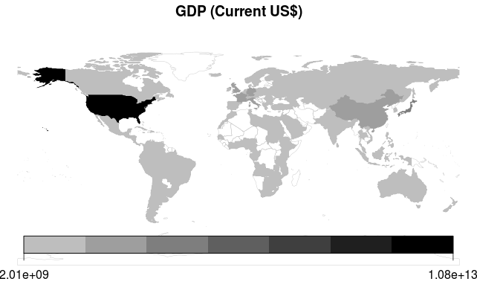



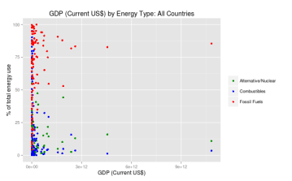
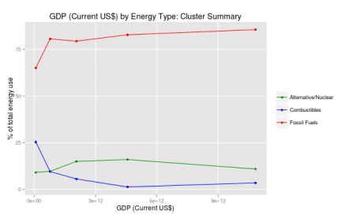
Start
SQL Database
World Bank Indicators API
R
Remove countries with missing data
Python
Produce heatmaps
GDP or
GDP per capita?
Plot all data points
Alternative/Nuclear
GDP
per
capita
Combustibles
Use k-means clustering to group countries based on GDP
GDP
Fossil Fuels
Find mean of GDP and energy proportions for each cluster
Plot cluster-based summary of data
Combine into data frame and send to SQL Database
End

Slide 4
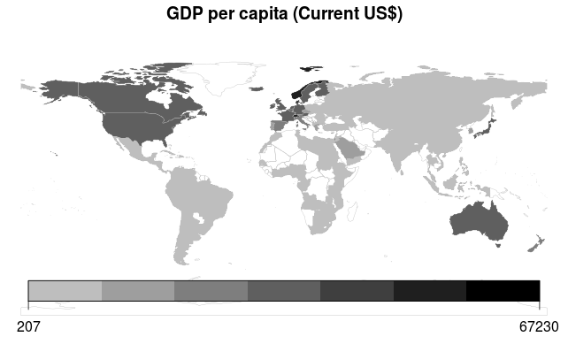

Slide 5
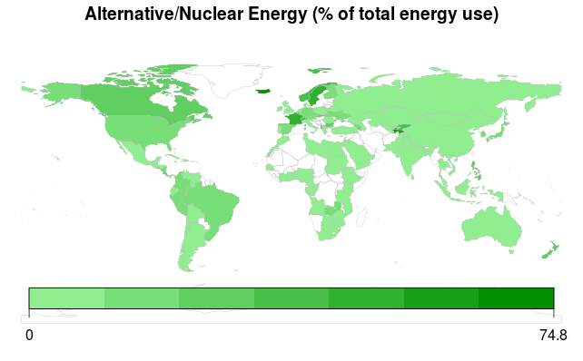

Slide 6
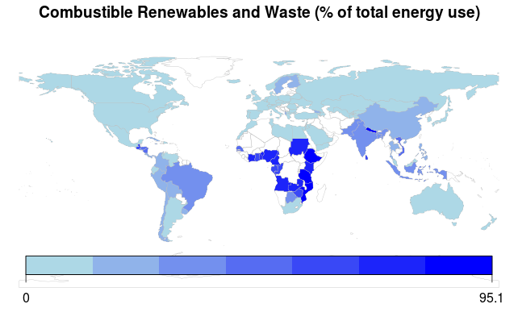

Slide 7
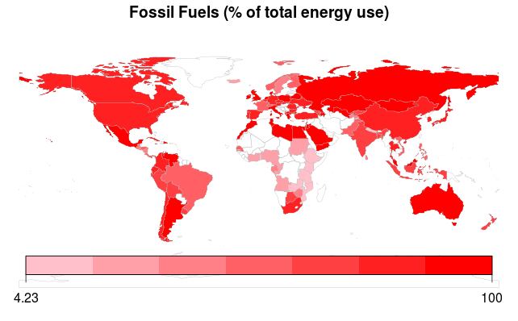

Slide 8


Slide 9


Slide 10
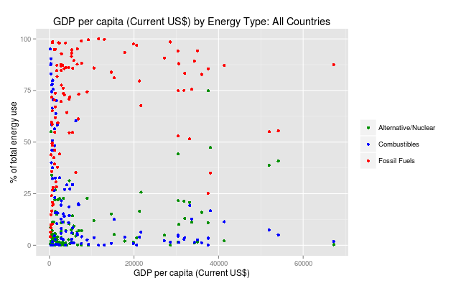

Slide 11
